Slide 1
Topic 1:
Depression Detection in Social Media
https://git.net9.org/OneSida/dlss_exp.git
2018.08.02
Notes:
1

Slide 2
Background - Depression
Depression is a leading cause of disability worldwide.
In clinical diagnosis, psychological doctors often make face-to-face interviews referring to the commonly used Diagnostic and Statistical Manual of Mental Disorders criteria, where nine classes of depression symptoms are defined.
Problem: effective but not proactive.
More than 70% of people in the early stages of depression would not consult the psychological doctors

Slide 3
Background – Social Media
Popular social media – Facebook, Twitter
User generated contents (UGC)
Emotions and moods
Daily lives & mental states
Advantage:
Proactive care
Depression behaviors

Slide 4
Our work - Task
Timely depression detection via harvesting social media.
Framework
Dataset collection from Twitter
Data preprocessing & feature extraction
Multimodal dictionary learning
Classify depressed users and make some behaviors analysis

Slide 5
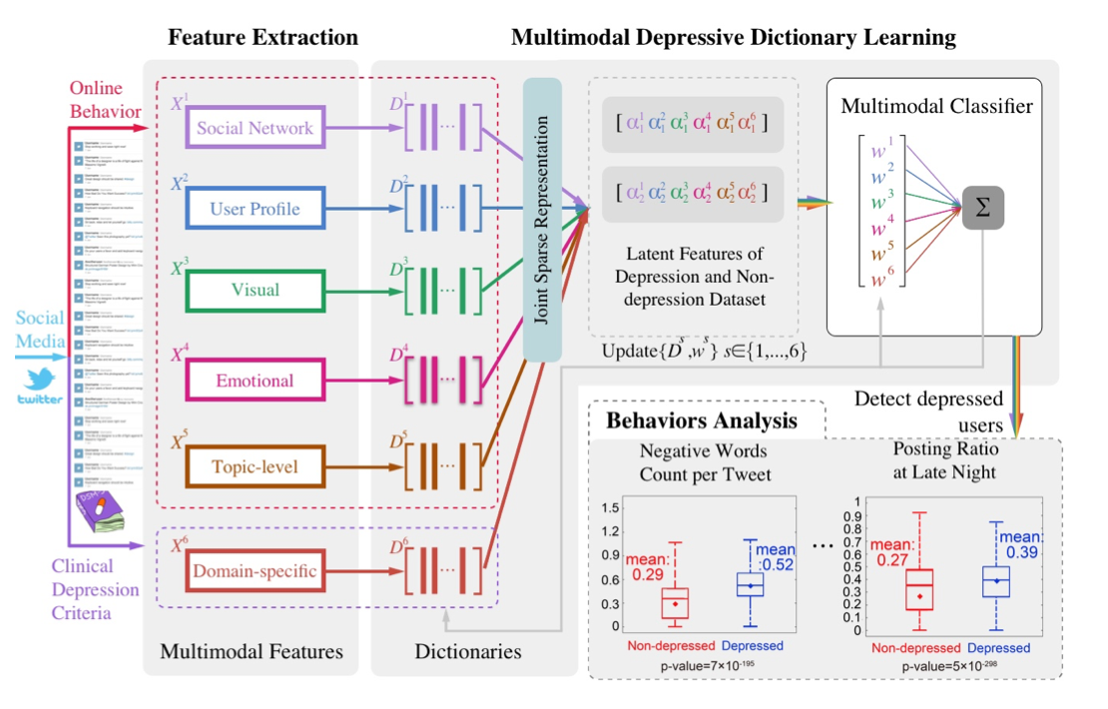
Our work - framework

Slide 6
Our work - Dataset
Twitter API
A sample
Profile information
Anchor tweet
Other tweets published within one month
Depression dataset
Sentence pattern “(I’m/ I was/ I am/ I’ve been) diagnosed depression”
Non-depression dataset
Never posted any tweet containing the character string “depress”

Slide 7
Our work - Features
Social network features
Number of tweets, social interactions, posting behaviors ...
User profile features
Genders, relationships ...
Visual features
Avatar: five-color combinations, brightness, saturation ...
Emotional features
Emotion words, emoji, VAD features
Topic-level features
unsupervised LDA: extract the topic distribution of the documents
Domain-specific features
Antidepressant, depression symptoms representations ...

Slide 8
Our work – model
Model: multimodal dictionary learning
Idea:
Learn the latent and sparse representation of users by dictionary learning (single modal)
Jointly model cross-modality relatedness to capture the common patterns and learn the joint sparse representations
Train a classiﬁer to detect depressed users with the learned features speciﬁcally
S. Bahrampour, N. M. Nasrabadi, A. Ray, and W. K. Jenkins, “Multimodal Task-Driven Dictionary Learning for Image Classification,” IEEE Transactions on Image Processing, pp. 1–16, Oct. 2015.

Slide 9
Our work - Experiments
Using multimodal dictionary learning method, under 5-fold cross validation, we get the performance with 85% in F1-Measure in macro-average.
Some findings:
Depressed users are more likely to post tweets between 23:00 and 6:00
Depressed users have both more positive words and negative words
Depressed users use more first personal pronouns
Depressed users post more antidepressant and depression symptoms words

Slide 10
Project Details - Background
Task: make timely depression detection via harvesting social media data. (That is, classify the users into depressed group and non-depressed group)
Data and features: as we have limited time, we have already extracted part of the features from the raw data crawled from Twitter and construct dataset (feature set).
Experiments: This experiment based on a high-level tensorflow API tf.contrib. This API is powerful and simple to use. (https://github.com/tensorflow/tensorflow/tree/r1.0/tensorflow/contrib)

Slide 11
Project Details - Steps
1. Split the data in depression_detection/data.csv into training set data file and testing set data file with a ratio about 3:2
2. Load the data from file, use the following function: tf.contrib.learn.datasets.base.load_csv_without_header
3. Normalize the data. We must normalize all the data at the same time, so we should combine the training set and testing set firstly, and split them apart after normalization.
4. Build linear classifier and dnn classifier with tf.contrib.learn. You should choose arguments yourself.
5. Fit and evaluate the model. You should compute accuracy, precision, recall and F1-score in macro-average.

Slide 12
Project Details - Grading
Grading (50 pts)
Split data (5 pts)
Load data (5 pts)
Normalize data (15 pts)
Build linear classifier with tf.contrib.learn (5 pts)
Build DNN classifier with tf.contrib.learn (5 pts)
Fit model (5 pts)
Make evaluation with specific metrics (10 pts)
You will get a performance at about 85~95%

Slide 13
Useful Tensorflow API
Here are some useful tensorflow APIs you may need:
tf.contrib.learn.datasets.base.* (dataset processing)
tf.concat (combine two tensors)
tf.slice (extracts a slice from a tensor)
tf.nn.l2_normalize (normalize a tensor)
tf.contrib.learn.LinearClassifier (basic linear classifier)
tf.contrib.learn.DNNClassifier (basic dnn classifier)
classifier.fit (fit the model with input training data)
classifier.evaluate (make evaluation with test data)

Slide 14
Basics – feature normalization
Feature normalization is a method used to standardize the range of independent variables or features of data.
Motivation
Make objective functions work properly: each feature contributes approximately proportionately to the final distance
Make gradient descent converges faster
http://sebastianraschka.com/Articles/2014_about_feature_scaling.html
https://www.wikiwand.com/en/Feature_scaling

Slide 15
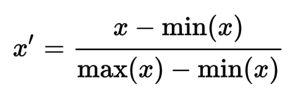
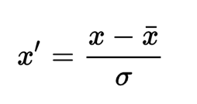
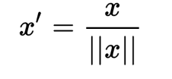
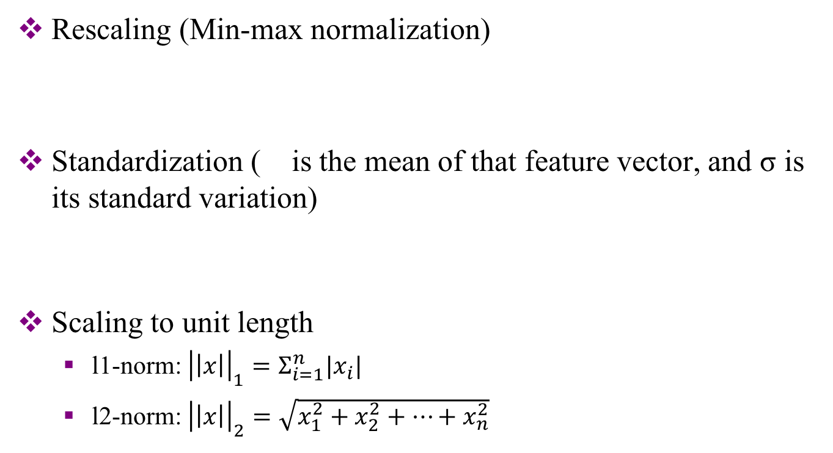
Basics – feature normalization
Rescaling (Min-max normalization)
Standardization ( is the mean of that feature vector, and σ is its standard variation)
Scaling to unit length
l1-norm: ${\left|\left|x\right|\right|}_{1}=Σ_{i=1}^{n}|x_{i}|$
l2-norm: ${\left|\left|x\right|\right|}_{2}=\sqrt{x_{1}^{2}+x_{2}^{2}+…+x_{n}^{2}}$

Slide 16
Basics– cross validation
In most case we have one dataset, and manually split them into training data and test data.
The effects of training and testing depend on how we divide the original dataset.
In order to reduce uncertainty, generally, we will divide dataset into several parts, for example, five parts. Then, in each round of training and testing, we use four parts combined as training set, one part left as test set. In one run, we do this for five times, ensuring each part can be used as test set once. That is called 5-fold cross validation.
With several randomized experimental runs, the results can be thought to be stable.

Slide 17
Basics – evaluation metrics
Classification (depressed users as Subjects of the study)
TP = True positives (depressed users predicted as depressed)
TN = True negatives (non-depressed users predicted as non-depressed)
FP = False positives (non-depressed users predicted as depressed)
FN = False negatives (depressed users predicted as non-depressed)
Metrics:
Accuracy (Micro average) = (TP+TN)/(TP+TN+FP+FN)
Recall = TP/(TP+FN)
Precision = TP/(TP+FP)
F1-score = 2*Recall*Precision/(Recall+Precision)
Macro average: arithmetic mean of metrics in each class (2 classes here)
precision in macro average: (TP / (TP + FP) + TN / (TN + FN))/2

Slide 18
Thanks

